Slide 1

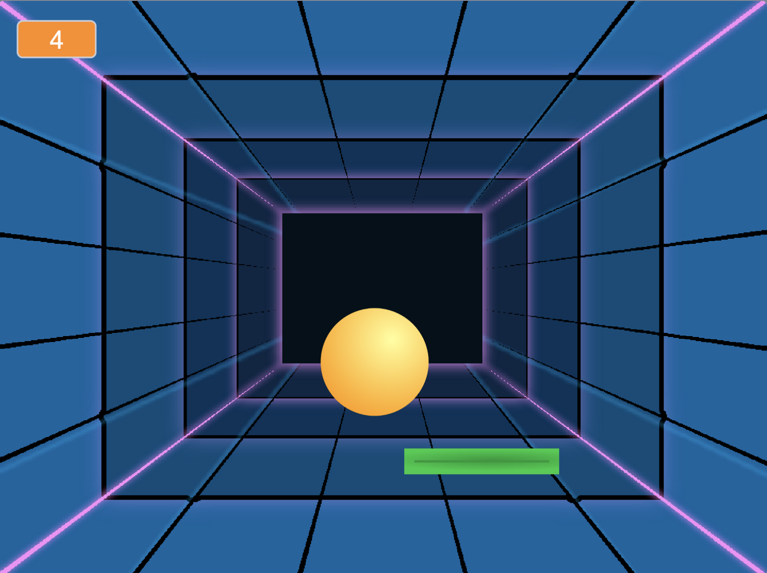
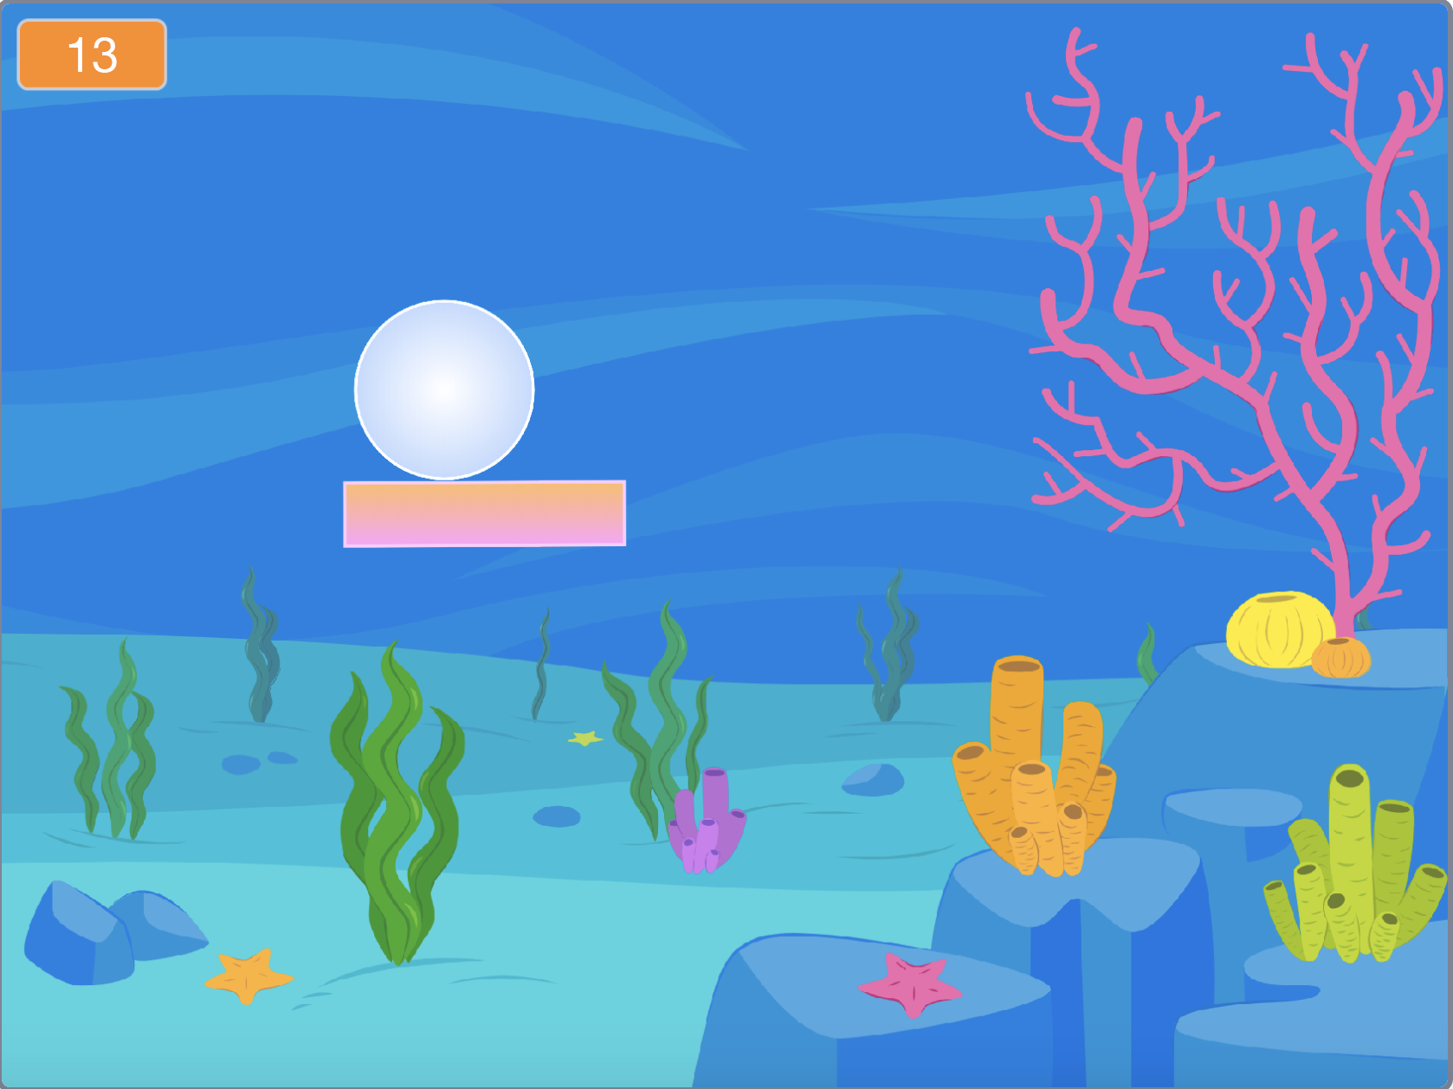

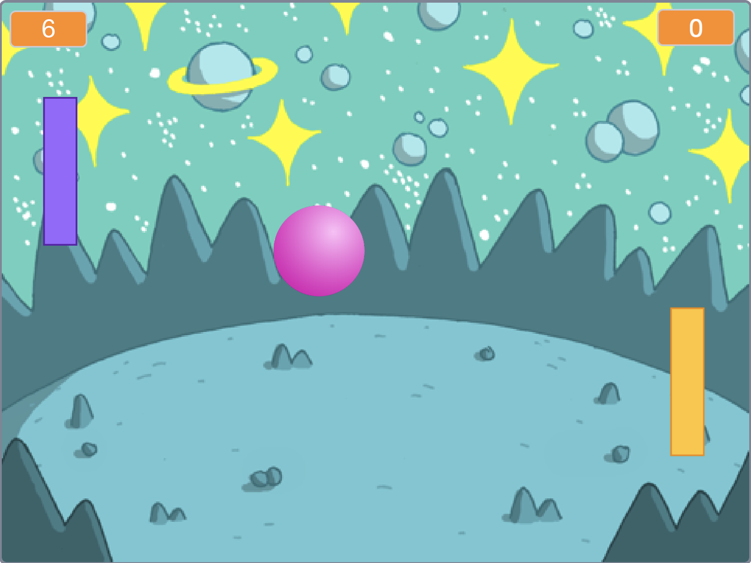


Pong Game Cards
Make a bouncing ball game and score points to win!
yyyymmdd
scratch.mit.edu
Set of 6

Slide 2
Pong Game Cards
Use these cards in this order:
Bounce Around
Move the Paddle
Bounce off the Paddle
Game Over
Score Points
Win the Game
scratch.mit.edu
Set of 6

Slide 3





Bounce Around
Make a ball move around the Stage.
yyyymmdd
Pong Game
1

Slide 4





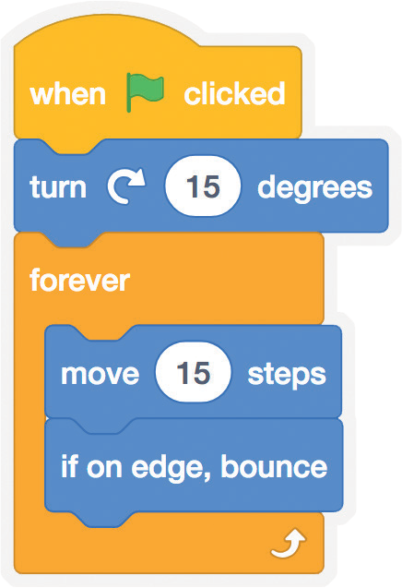


Bounce Around
scratch.mit.edu
GET READY
Choose a backdrop.
Neon Tunnel
Choose a ball.
ADD THIS CODE
Ball
Type a larger number to move faster.
TRY IT
Click the green flag to start.

Slide 5



Move the Paddle
Control a paddle by moving your mouse pointer.
yyyymmdd
Pong Game
2

Slide 6


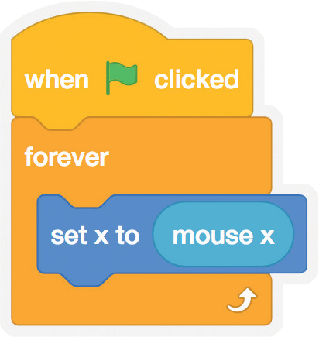



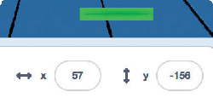
Move the Paddle
scratch.mit.edu
GET READY
Paddle
Choose a sprite for hitting the ball, like Paddle.
Then, drag your paddle to
the bottom of the Stage.
ADD THIS CODE
Insert the mouse x block into the set x to block.
Paddle
TRY IT
Click the green flag to start.
Move your mouse pointer to move the paddle.
TIP
You can see the x position of the paddle change as you move the mouse pointer across the Stage.

Slide 7



Bounce Off the Paddle
Make the ball bounce off the paddle.
yyyymmdd
Pong Game
3

Slide 8
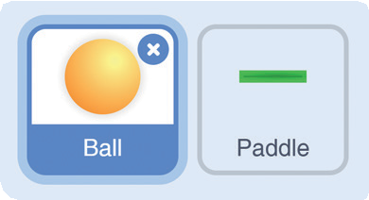
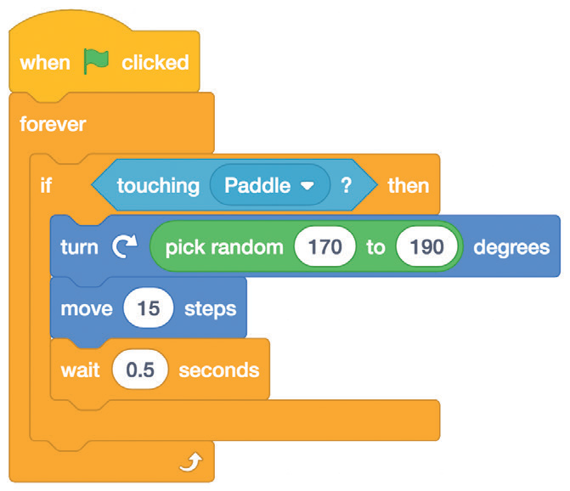
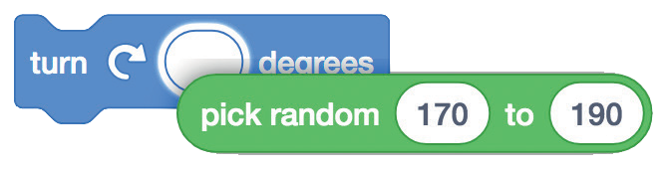

Bounce Off the Paddle
scratch.mit.edu
GET READY
Click to select the Ball sprite.
ADD THIS CODE
Add this new stack of blocks to your Ball sprite.
Choose Paddle from the menu.
Ball
Insert the pick random
block and type in 170 to 190
TRY IT
Click the green flag to start.

Slide 9

Game Over
Stop the game if the ball hits the red line.
yyyymmdd
Pong Game
4

Slide 10


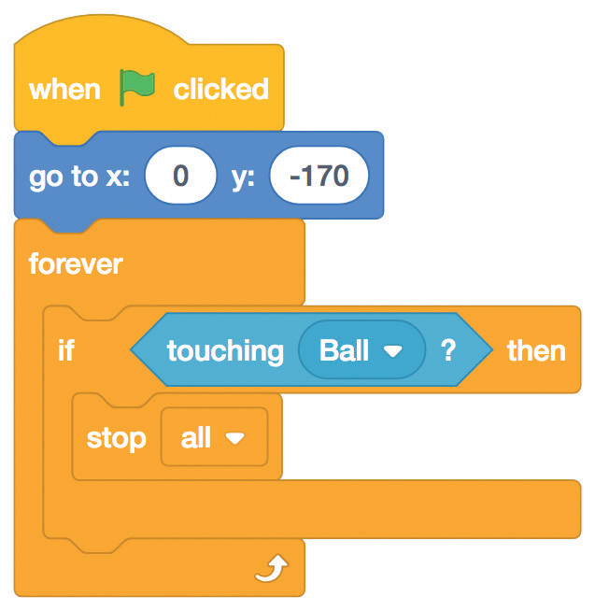

Game Over
scratch.mit.edu
GET READY
Line
Choose the sprite called Line.
Drag the Line sprite to the bottom of the Stage.
ADD THIS CODE
Line
Set the position of the Line.
Choose Ball
from the menu.
TRY IT
Click the green flag to start.

Slide 11
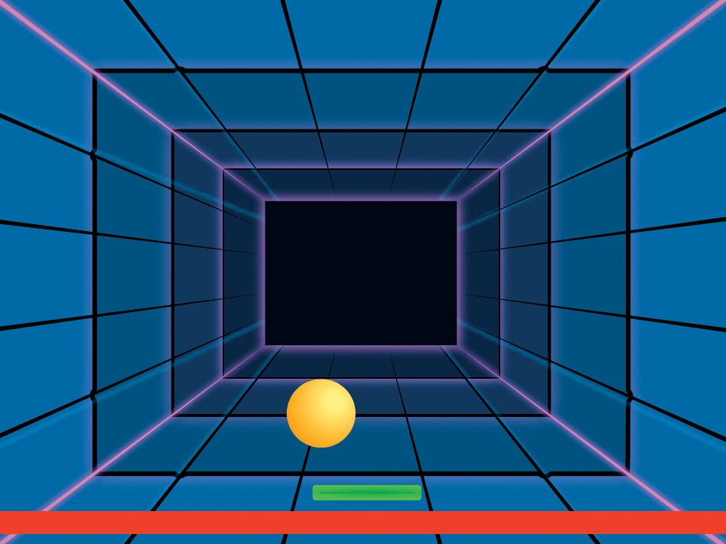



Score Points
Add a point each time you hit the ball with the paddle.
yyyymmdd
Pong Game
5

Slide 12
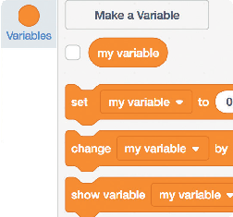
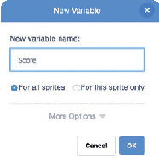
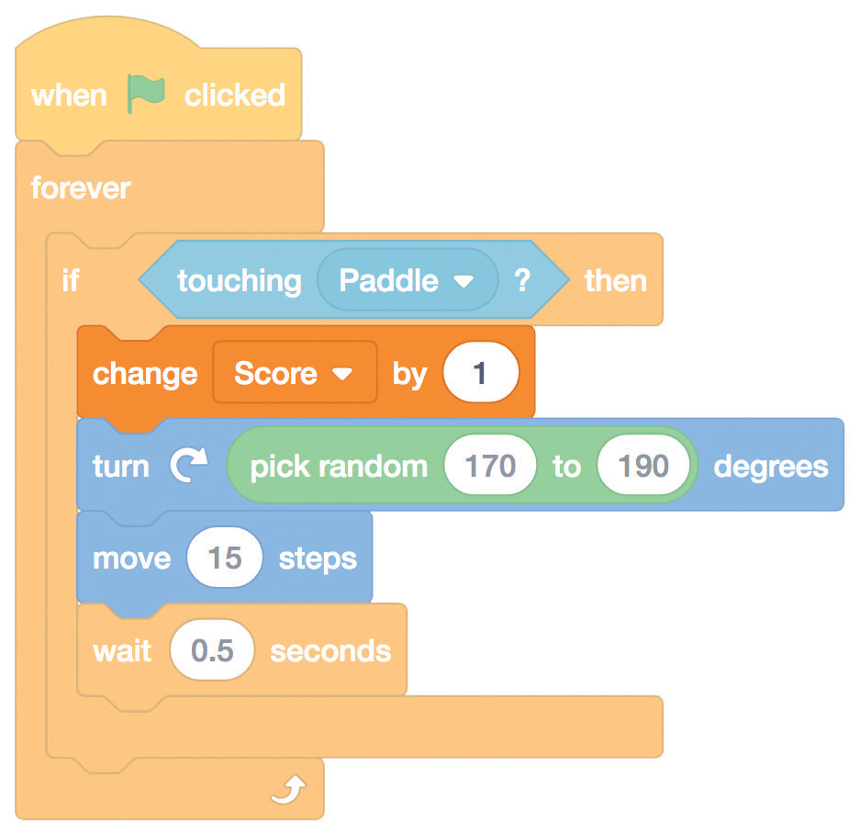
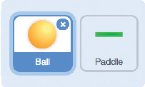
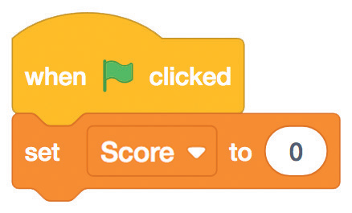
Score Points
scratch.mit.edu
GET READY
Choose Variables.
Click the Make a Variable button.
Score
Name this variable Score
and then click OK.
ADD THIS CODE
Click to select the Ball sprite.
Add this block and choose Score from the menu.
Use this block to reset the score. Choose Score from the menu.

Slide 13
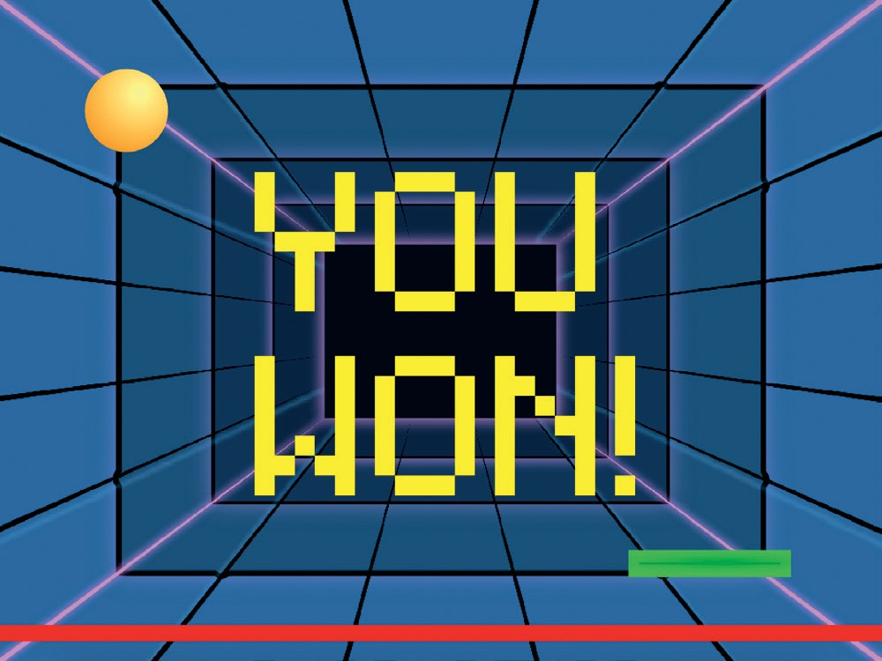
Win the Game
When you score enough points, display a winning message!
yyyymmdd
Pong Game
6

Slide 14
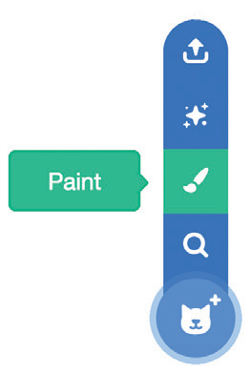


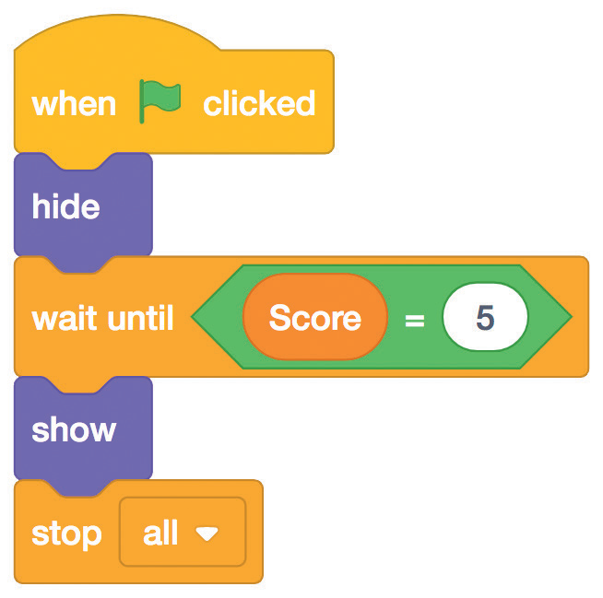

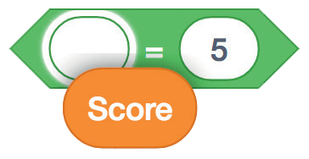
Win the Game
scratch.mit.edu
GET READY
Use the Text tool to write a message, like “You Won!”
Click the Paint icon to make a new sprite.
You can change the font color, size, and style.
ADD THIS CODE
Click the Code tab.
Type the number of points needed to win the game.
Insert the Score block into the equals block from the Operators category.
TRY IT
Click the green flag to start.
Play until you score enough points to win!

